Slide 1
The Depressed Brain: An Evolutionary Systems Theory

Slide 2
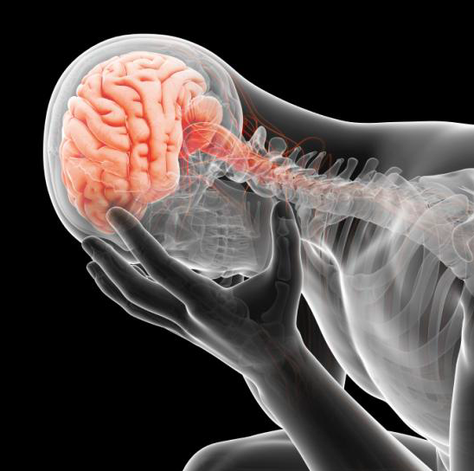
What is depression?
Neurocognitive Deficits
Behavioural Deficits

Slide 3
It serves as an adaptive function
species-typical capacity

Slide 4
Free-Energy Principle
and Evolutionary View-point (EST)

Slide 5
Psychopathology
as an ineffectual attempts to alleviate.
social stress

Slide 6
Ecological
Ontogenetic
Bio-behavioural
Depressive brain correlates

Slide 7
The Brain
Hierarchical
Self Organising System
Dynamic systems(?) - situate the brain within the evolutionary dynamics of
the brain-body-environment system?
* Enculturation
* Development

Slide 8
Connecting Both
FEP - How depressive disorder emerge from hierarchical neuro-dynamics
Adaptive Function of Depression

Slide 9
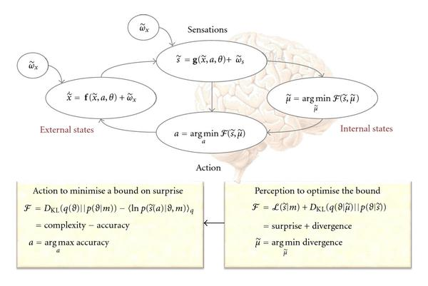
Free-Energy Principle
Predictive Coding?

Slide 10
Hierarchy generative model of hypothesis (world) too other than the hierarchy in BRAIN
What is top-down prediction?

Slide 11
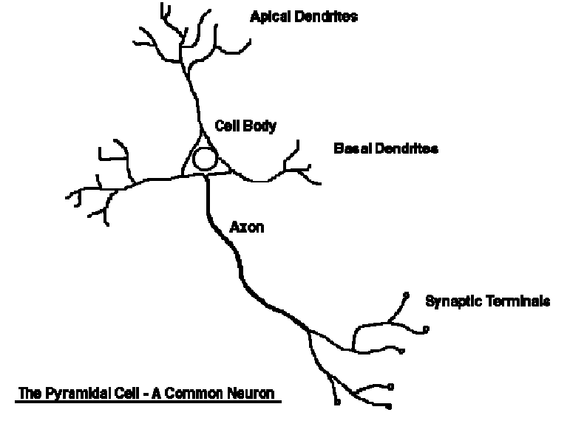
Conditional Expectations = Deep Pyramidal Cells
ONE WAY.
Sending Signal Below (in brain hierarchy) to minimise further surprises (can be seen as error) in future

Slide 12
ANOTHER WAY.
Selectively sample sensory data by - Active Inference
Corollary - Our predictions are optimised by evolution, development,
learning.

Slide 13
With emphasis on adaptive priors -- inheritance

Slide 14
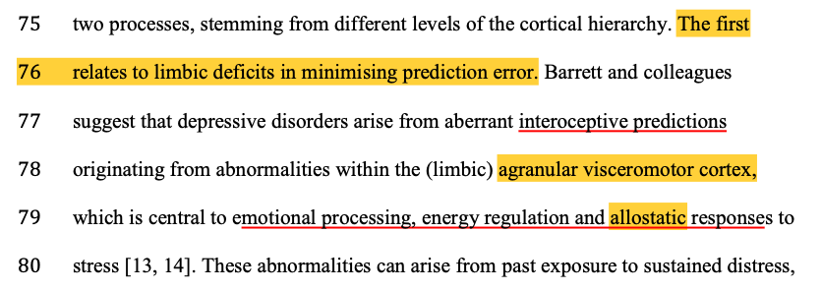
Applications of the FEP to depressive disorders have chiefly concentrated on two processes
Limbic (agranular visceromotor cortex)
The visceromotor systems try to minimise prediction error by producing sickness behaviours

Slide 15
Second.
Impairments in top-down expectations of reward.
Depressed brain as a hierarchical constellation of depressive beliefs.
ADDING Active Inference. --- Learned Helplessness

Slide 16
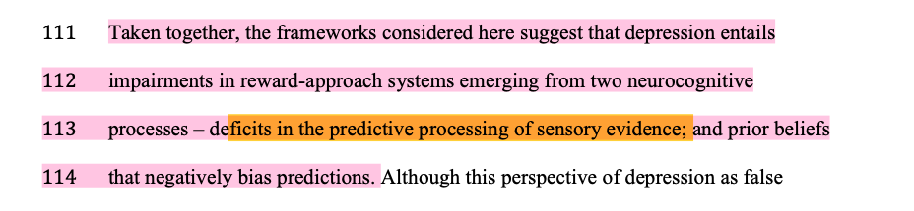

Slide 17

Questions Remaining
(NEGATIVE MOODS) RECENT > PRIOR
Species-typical capacity of depressed or low mood

Slide 18
Resume.

Slide 19
Insights from an Evolutionary Systems Approach to Psychology
Dynamic interplay between
EVOLUTIONARY
DEVELOPMENTAL

Slide 20
Tinbergen
Brain and Behaviour emerges

Slide 21
Adaptation
Phylogeny (?)
Ontogeny
Mechanism

Slide 22
146
Ultimate Hypothesis -> Adaptive
Epigenetic -> Intergenerational (?)
Dynamic -> Individual similarity and difference
Mechanistic -> Real-time Phenomena

Slide 23
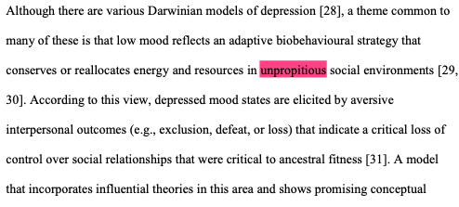

Slide 24
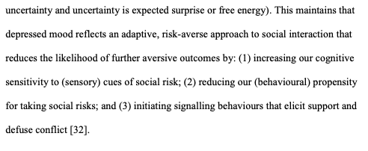

Slide 25
Social Risk Hypothesis

Slide 26
Risk arises during adolescence*
Protective Factors --- Social Support and belongings
Social-threatening Stimuli (increased sensitivity)
Ruminations about interpersonal problems.

Slide 27
“Better safe than sorry”
Strategy

Slide 28
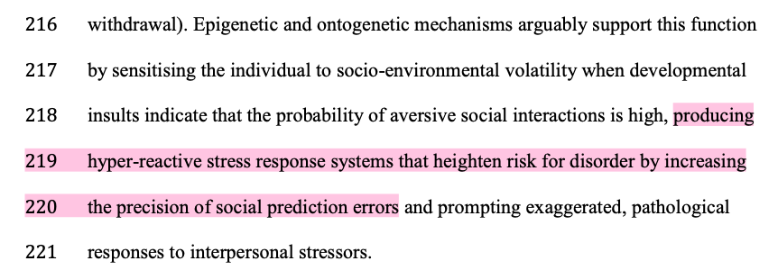
Increasing precision??

Slide 29
Depressed brain can be interpreted as a maladaptive pattern of dysregulated defences

Slide 30
The Depressed Brain

Slide 31
Hierarchically Organisation (neural regions)
Interaction
Amygdala and ventral striatum (VENTRAL AFFECTIVE)
PFC => modulating the reactions

Slide 32
Unconscious Processing
Social Stimuli and Adaptation

Slide 33
Dysfunction of the “extended visceromotor network”
Increasing the precision of social prediction errors
ACTIVE INFERENCE COMES INTO PLAY
-- NEGATIVE BIAS

Slide 34
PFC
Underwriting the formation of distal goals

Slide 35
Adaptive increases learning, but at the same time with a bias ----> it goes downward.
Sensory Attenuation?

Slide 36
Conclusion

Slide 37
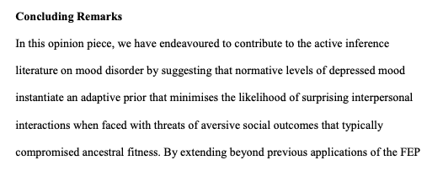

Slide 38
It also motivates new questions for research, calling for greater integration between neuroscientific and psychological approaches
to explore the ways in which the neural mechanisms that underpin depression relate to behaviour, development and the social world.

Slide 39
Social and Non-Social
Proinflammatory immune responses induced by illness and medication
Develop tools -- to distinguish

Slide 40
Interventions
Therapy --- FEP --- S, NS --- Framework for Clients

Slide 41
End.

